Slide 1

The
Project work on
WIRELESS ELECTRIC VEHICLE CHARGING SYSTEM
Under the esteemed guidance of
Mr. A Abhishek Reddy
M.Tech,(Ph.D)
Assistant Professor
Batch-23
K. SWETHA 1608-23-735-090
R. CHARAN 1608-23-735-099
Department of Electronics and Communication Engineering
(NBA Accreditation)
MATRUSRI ENGINEERING COLLEGE
(Sponsored by Matrusri Education Society, Estd1980)
(Approved by AICTE, Affiliated to Osmania University)
#16-1-486, Saidabad, Hyderabad, Telangana-500 059
www.matrusri.edu.in
2025-26
Notes:
1

Slide 2
CONTENTS
INTRODUCTION
LITERATURE SURVEY
PROBLEM STATEMENT
OBJECTIVES
PROPOSED METHOD
BLOCK DIAGRAM
SCHEMATIC DIAGRAM
COMPONENTS
ADVANTAGES
APPLICATIONS
CONCLUSION
RESULT
REFERENCE

Slide 3
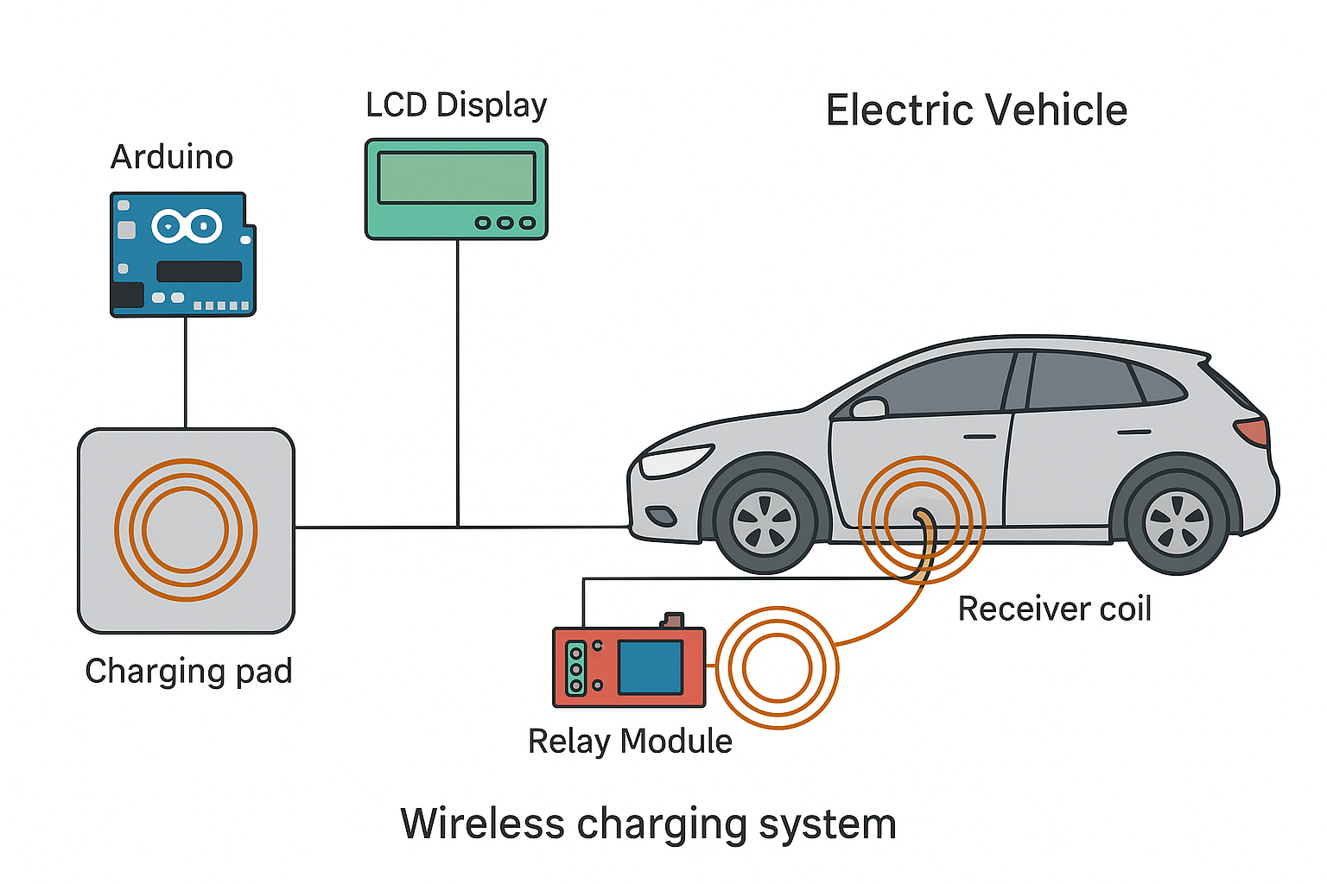
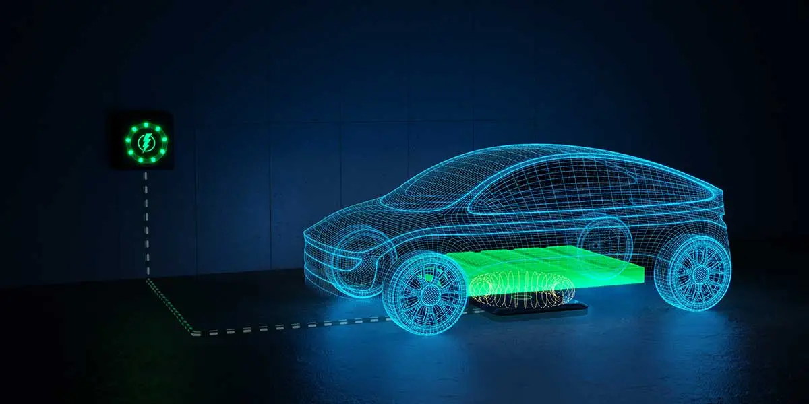
Introduction
With the rapid growth in electric vehicle (EV) adoption, the demand for efficient and reliable charging systems is increasing.Traditional plug-in methods often suffer from cable wear, limited flexibility, and human errors during connection.To address these issues, this project develops a Wireless Electric Vehicle Charging System for contactless power transfer.The system uses inductive coupling between a transmitter coil on the charging pad and a receiver coil in the vehicle.An Arduino microcontroller controls the setup, supported by IR sensors, a relay module, and an LCD with I2C interface.The IR sensors detect the vehicle’s presence and alignment over the charging pad.Based on sensor input, the Arduino activates the relay to enable safe and efficient wireless charging.The LCD provides real-time charging status, improving user interaction and monitoring.This wireless design eliminates physical connectors, reducing wear and increasing safety from electrical hazards.Overall, the system offers a smart, automated, and sustainable solution for the future of EV charging infrastructure..

Slide 4
Literature survey
S.No
Paper
Description
1. | 1. A. Kurs , A Karalis, “Wireless power transfer via strongly coupled magnetic resonances,” Science, vol. 317, no. 5834, pp. 83–86, 2007. | This pioneering study demonstrated efficient mid-range wireless power transfer using strongly coupled magnetic resonances. It laid the foundation for modern wireless power transfer systems by proving the feasibility of contactless energy transmission.
2. | 2. S. D.Barman,A.W.Reza,N.Kumar, “Wireless powering by magnetic resonant coupling: Recent trends in wireless power transfer system and its applications,” Renewable and Sustainable Energy Reviews, vol. 51, pp. 1525–1552, 2015. | This review highlights advancements in magnetic resonant coupling-based wireless power transfer, focusing on system design, energy efficiency, and real-world applications such as electric vehicle charging and biomedical devices.
3. | X. Zhang,Y.Yuan.,Q.Yang, “Coil design and efficiency analysis for dynamic wireless charging system for electric vehicles,” IEEE Transactions on Magnetics, vol. 52, no. 7, pp. 1–4, 2016. | This paper investigates the optimization of coil geometry and positioning for dynamic (in-motion) wireless EV charging. The study provides analytical and simulation-based results to enhance power transfer efficiency.
4. | A. N. Azad,V.A.Kulyukin.,R.Zane,R.pantic, “Analysis, optimization, and demonstration of a vehicular detection system intended for dynamic wireless charging applications,” IEEE Transactions on Transportation Electrification, vol. 5, no. 1, pp. 147–161, 2019 | The authors propose a vehicle detection and alignment system that improves charging accuracy in dynamic wireless charging scenarios. It integrates optimization methods for efficient and safe power transmission during vehicle movement.

Slide 5
Problem Statement
Wireless electric charging for electric vehicles (EVs) aims to eliminate the need for plug-in chargers by enabling automatic, contactless power transfer. The challenge lies in designing an efficient inductive or resonant charging system that minimizes energy loss during transmission. Alignment issues between the vehicle and charging pad can significantly affect performance. Additionally, system safety, interoperability, and cost-effectiveness must be ensured for large-scale adoption. The problem focuses on optimizing charging efficiency, convenience, and reliability while maintaining environmental and economic sustainability.

Slide 6
Objective
The objective of this project is to design and implement a wireless charging prototype for electric vehicles.The system efficiently transfers power over a small air gap, demonstrating feasibility for real-world use.IR sensors detect the presence of an EV, and an Arduino processes this data to control charging.Upon detection, a relay activates the transmission coils to enable contactless energy transfer.An LCD with an I2C interface displays real-time charging status for user convenience.The wireless setup eliminates physical connectors, reducing wear and maintenance issues.Overall, the system enhances safety, efficiency, and ease of use in EV charging applications.
Notes:
6

Slide 7
PROPOSED METHOD
The proposed system uses IR sensors to detect the presence of an EV. The Arduino processes the sensor data and activates a relay to power the transmission coils, enabling wireless charging. The LCD with 12C displays the charging status, providing real-time updates to the user. This system offers several advantages, including reduced downtime, enhanced convenience, and the ability to charge vehicles wireless without requiring physical connections.

Slide 8
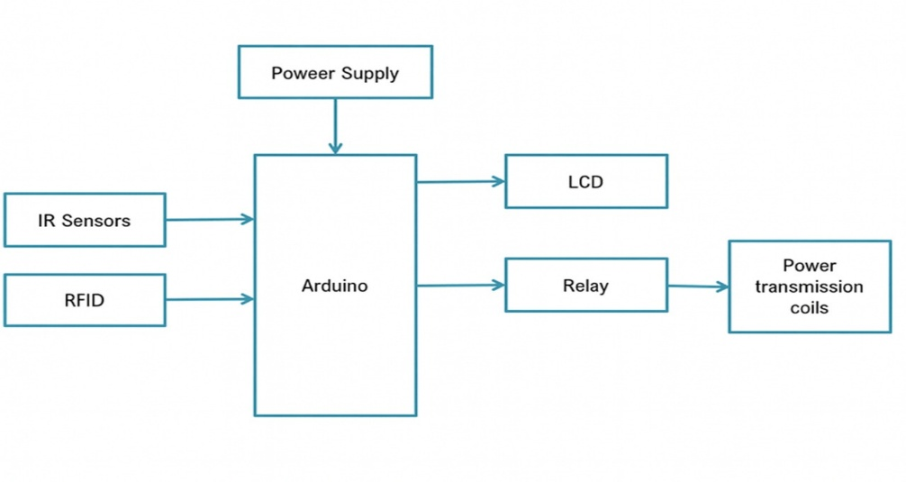
BLOCK DIAGRAM
F

Slide 9
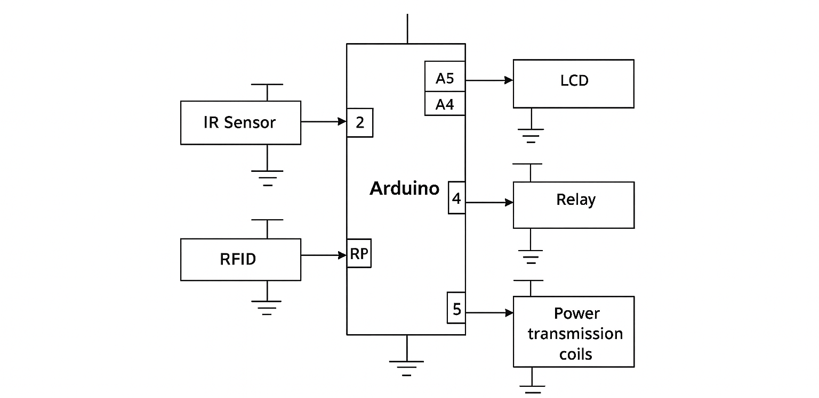
SCHEMATIC DIAGRAM

Slide 10
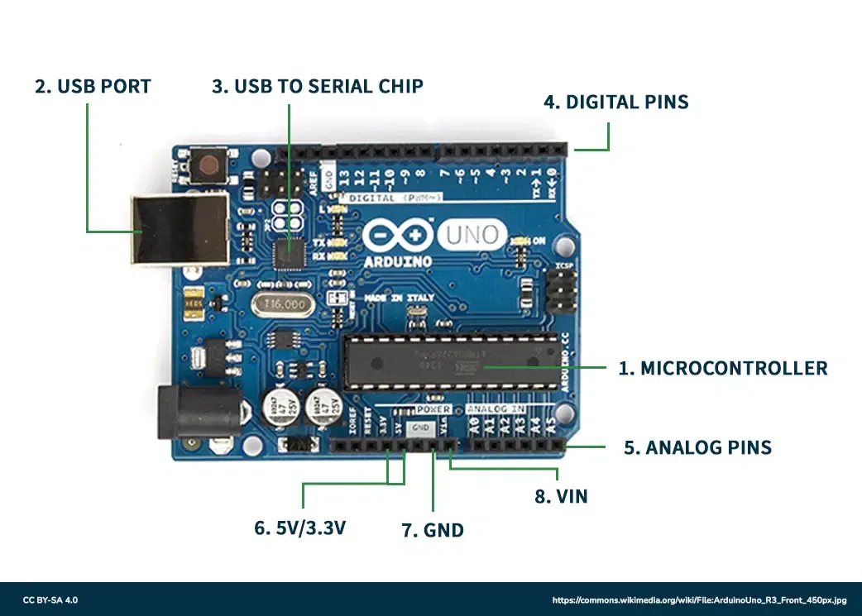
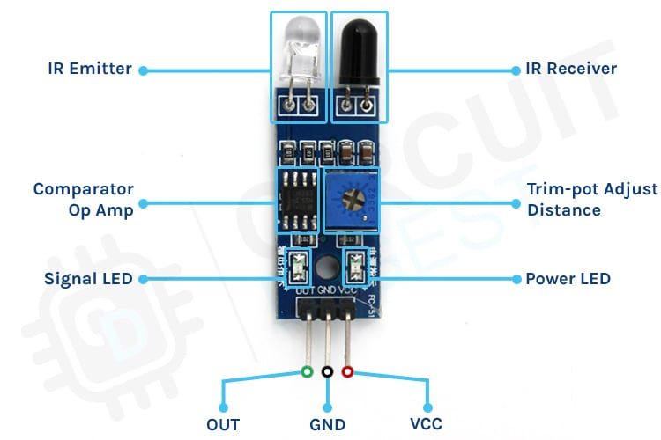
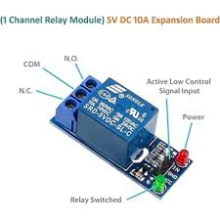
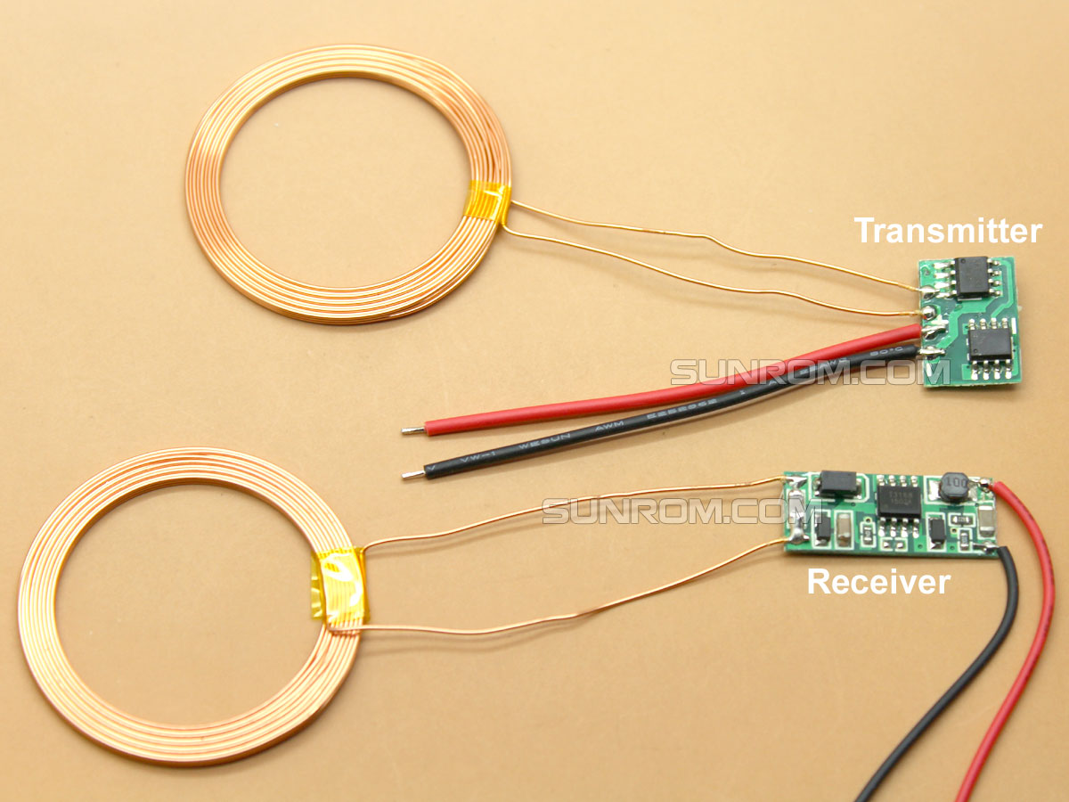
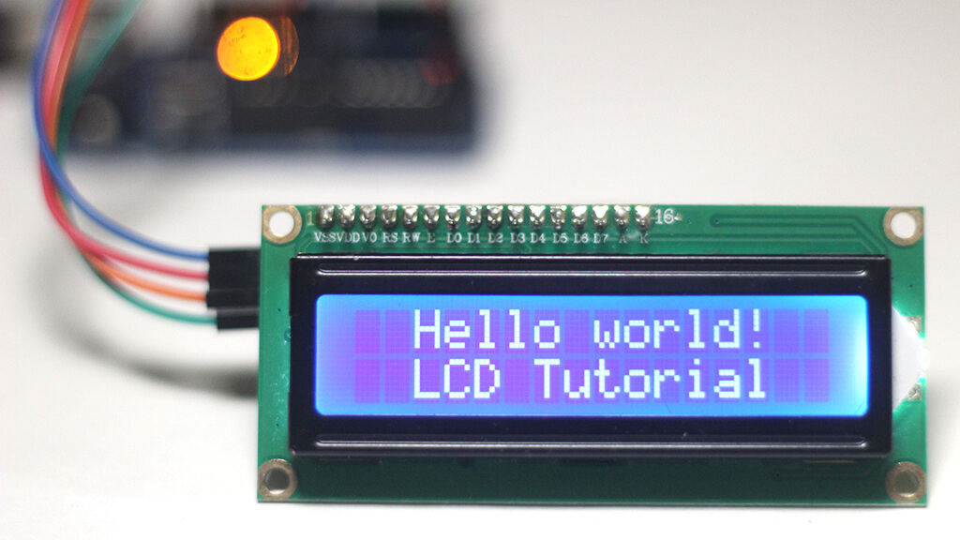
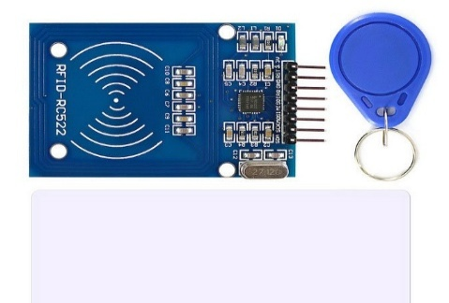
COMPONENTS USED
Arduino UNO
IR Sensor Module
Relay Module
Wireless Power Transmission Coils
Liquid crystal display(LCD)
RFID

Slide 11
Arduino UNO
The Arduino Uno serves as the central control unit in a Wireless EV Charging System.It regulates the inverter’s switching frequency to maintain resonance for efficient power transfer.The board processes data from voltage, current, and proximity sensors to detect vehicle presence and adjust power flow.It also communicates with display or wireless modules to show system status and parameters.Overall, the Arduino Uno ensures automated, efficient, and optimized wireless EV charging control.
The transmitter and receiver coils are the core components of a Wireless Power Transmission System.The transmitter coil generates a time-varying magnetic field using high-frequency alternating current.When the receiver coil is placed within this field, an EMF is induced according to Faraday’s Law.This induced voltage is converted to DC power for charging the battery or running the load.Power transfer efficiency depends on coil distance, alignment, size, and resonant frequency.When both coils are tuned to the same frequency, resonant inductive coupling ensures efficient wireless energy transfer.
Wireless power transmission coils

Slide 12
IR Sensor Module
The Infrared (IR) sensor module detects the presence, distance, or motion of objects using infrared light.It consists of an IR transmitter (LED) and an IR receiver (photodiode or phototransistor).The transmitter emits invisible IR light that reflects off nearby objects.The receiver detects the reflected light and converts it into an electrical signal.A comparator circuit processes this signal and outputs a digital HIGH or LOW to indicate detection.The sensor’s range and sensitivity can be adjusted using a built-in potentiometer.It is widely used in robotics, automation, obstacle detection, and safety systems.
Liquid Crystal Display(LCD)
A Liquid Crystal Display (LCD) is an electronic display technology used to show visual information.It operates by manipulating light through liquid crystals that change orientation when an electric field is applied.These crystals do not emit light themselves but rely on a backlight or reflector for visibility.The display is made up of multiple layers, including polarizers, glass substrates, and electrodes.
Overall, LCDs offer a reliable and efficient way to display information in modern electronic systems.

Slide 13
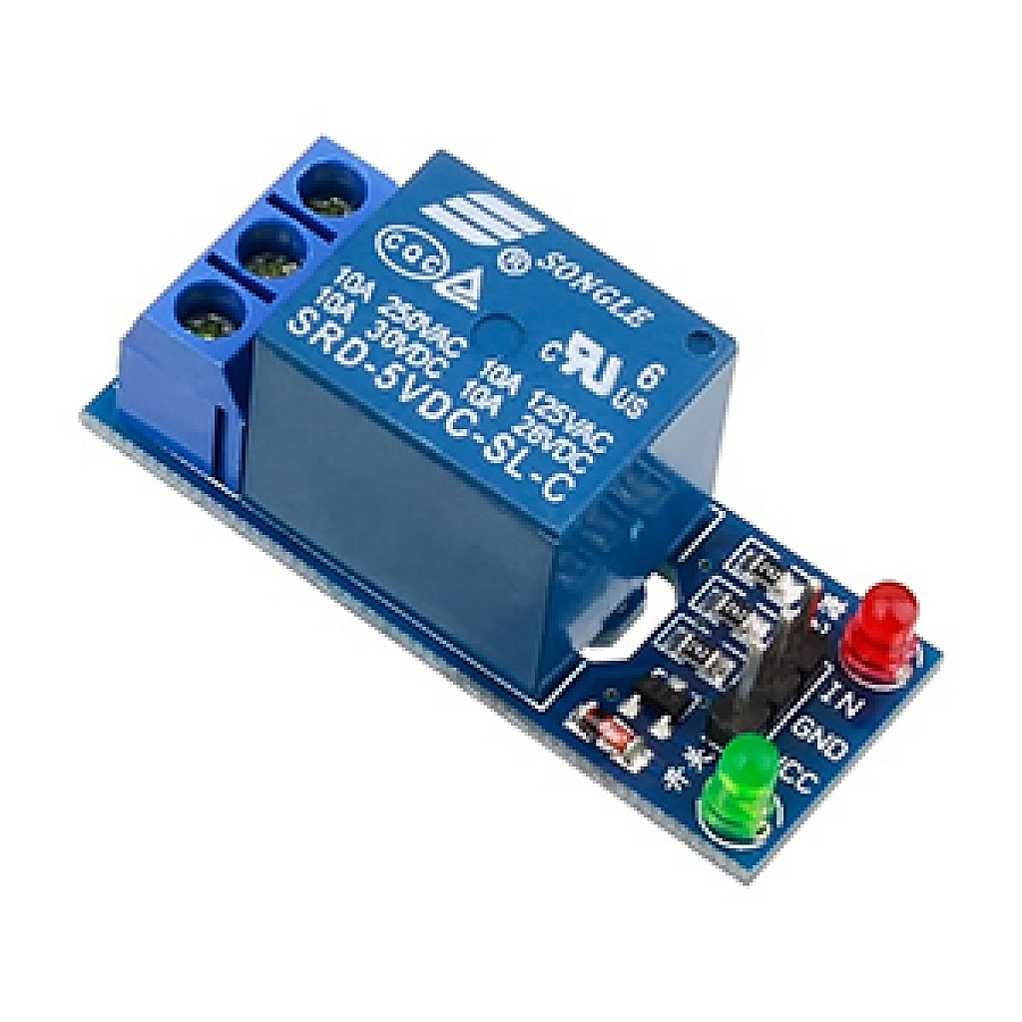

Relay Module
In a Wireless EV Charging System, the relay module acts as an electronically controlled switch that allows the microcontroller (such as Arduino Uno) to safely turn the high-power charging circuit ON or OFF. It activates charging only when the vehicle is properly aligned and ready, and disconnects power when the vehicle is removed or a fault is detected. This protects the system from overcurrent, short circuits, overheating, and power fluctuations. Overall, the relay ensures safe, automated, and reliable wireless charging.
Software Specification
ARDUINO IDE
FEATURES OF ARDUINO IDE
DATA TYPES FOR ARDUINO IDE
UPLODING THE ARDUINO BOARD PROGRAM
ARDUINO CODE STRUCTURE

Slide 14
RFID
The RFID module is used for user or vehicle authentication before enabling the wireless charging process. The RFID reader is connected to the Arduino and reads the unique ID from an RFID card or tag. When a valid tag is detected, the RFID module sends the identification data to the Arduino for verification. The Arduino compares this data with the pre-stored authorized IDs in its memory. If the ID is valid, the Arduino allows the system to proceed further. Based on this confirmation, the Arduino activates the relay module. The relay then enables power flow to the power transmission coils. If an unauthorized RFID tag is detected, the relay remains OFF, preventing power transfer. The LCD displays the authentication status such as “Access Granted” or “Access Denied.” Thus, the RFID module adds an important layer of security to the wireless EV charging system.

Slide 15
ADVANTAGES
Faster charging speeds (up to 100 kW).
Improved safety features and reduced risk of electrical shock or fire.
Increased scalability and flexibility for large-scale deployment.

Slide 16
APPLICATIONS
Enables automatic charging in public parking areas.
Provides convenient cable-free charging at homes.
Supports smart city EV infrastructure.
Charges electric buses and taxis at stops or stations.
Ideal for autonomous and self-driving vehicles.
Powers industrial EVs like forklifts and AGVs wirelessly.
Allows dynamic charging on specially equipped roadways.
Enhances fleet charging efficiency for commercial vehicles.

Slide 17
CONCLUSION
The Wireless Electric Vehicle Charging System using arduino represents a significant advancement in wireless energy transmission. By addressing the limitations of existing WPT systems and incorporating modern micro controller technology, advanced sensors, and optimized circuit design, our proposed system offers a reliable, efficient, and user-friendly solution for various applications. The project demonstrates WPT technology's potential to revolutionize power transmission, providing benefits such as enhanced convenience, improved safety, and increased efficiency. The capabilities of Arduino and other modern components, we have created a functional prototype showcasing WPT principles and practical applications.
Successful implementation highlights the importance of interdisciplinary collaboration in advancing technology. Future work could focus on extending WPT range, enhancing efficiency, and exploring new materials and designs to reduce energy losses and heat generation. Integrating advanced control algorithms could enable more intelligent and adaptive systems, optimizing power transfer in real- time based on dynamic conditions.

Slide 18
RESULT
The wireless electric vehicle charging system successfully demonstrated contactless power transfer using transmitter and receiver coils. The IR sensor accurately detected the presence of a vehicle and activated the charging process through the microcontroller. The relay responded effectively, enabling controlled power flow to the transmission coils. The LCD display provided real-time system status and charging indications. The system operated safely with proper grounding and stable component integration. Overall, the prototype validated efficient wireless charging over a short distance. This result confirms that the designed model is feasible for future expansion into real-time EV charging applications.

Slide 19
References
1.A. Kurs, A. Karalis, R. Moffatt, J. D. Joannopoulos, P. Fisher,M. Soljačić, Wireless power transfer via strongly coupled magnetic resonances, Science 317 (5834) (2007) 83-86.
2.S. Chhawchharia, S. K. Sahoo, M. Balamurugan, S. Sukchai,F. Yanine, Investigation of wireless power transfer applications with a focus on renewable energy, Renewable and Sustainable Energy Reviews 91 (2018) 888-902.
3.S. D. Barman, A. W. Reza, N. Kumar, M. E. Karim, A. B. Munir, Wireless powering by magnetic resonant coupling: Recent trend sin wireless power transfer system and its applications, Renewable and Sustainable Energy Reviews 51 (2015) 1525-1552.
4.X. Zhang, Z. Yuan, Q. Yang, Y. Li, J. Zhu, Y. Li, Coil design and efficiency analysis for dynamic wireless charging system for electric vehicles, IEEE Transactions on Magnetics 52 (7) (2016) 1-4.
5.A. N. Azad, A. Echols, V. A. Kulyukin, R. Zane, Z. Pantic, Analysis, optimization, and demonstration of a vehicular detection system intended for dynamic wireless charging applications, IEEE Transactions on Transportation Electrification 5 (1) (2019) 147-161.
6.M. Longo, D. Zaninelli, G. Cipriani, V. Di Dio, R. Miceli, Economic analysis on the use of wired and wireless recharging systems, in:2017 IEEE International Conference on Environment and Electrical Engineering and 2017 IEEE Industrial and Commercial Power Systems Europe (EEEIC/ I CPS Europe), 2017, pp. 1-6.
7.F. M. Eltoumi, M. Becherif, A. Djerdir, H. Ramadan, The key issues of electric vehicle charging via hybrid power sources:Techno-economic viability, analysis, and recommendations, Renewable and Sustainable Energy Reviews 138 (2021) 110534.
8.D. M. Vilathgamuwa, J. P. K. Sampath, Wireless Power Transfer (WPT) for Electric Vehicles (EVS) Present and Future Trends, Springer Singapore, Singapore, 2015, pp. 33-60.
9.A. Vallera, P. Nunes, M. Brito, Why we need battery swapping technology, Energy Policy 157 (2021) 112481.
10.F. Tuchnitz, N. Ebell, J. Schlund, M. Pruckner, Development and evaluation of a smart charging strategy for an electric vehicle fleet based on reinforcement learning, Applied Energy 285 (2021) 116382.

Slide 20
Thank You

